Slide 1



SRIKANTH PITTALA
Team Lead –Automation Engineer (QA)
Totally 6+ years of experience
Languages : Java, c#, python
Tools : Selenium (Web) , Mobile Testing, API Testing & JMeter(Performance)
DB : Microsoft SQL- Server

Slide 2
Fundamentals
Quality Assurance
Quality Analyst
Manual Testing
Automation Testing
3 Tire Architecture
Scope of automation testing

Slide 3
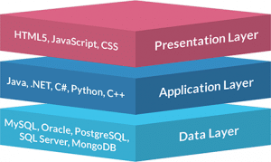
3 tier architecture

Slide 4
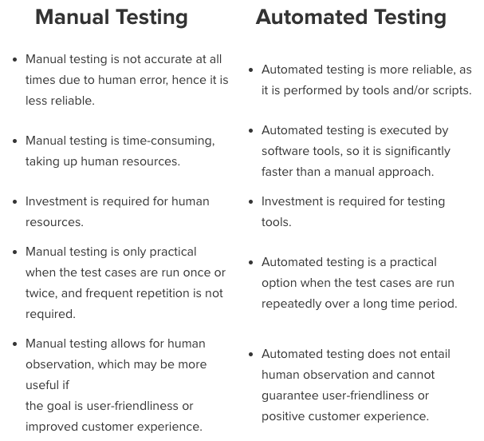

Slide 5

Automation Engineer
Java / c# / python
Selenium (UI)
API Testing
Mobile Testing
SQL Server (DB)
JMeter (Performance)
CI & CD

Slide 6
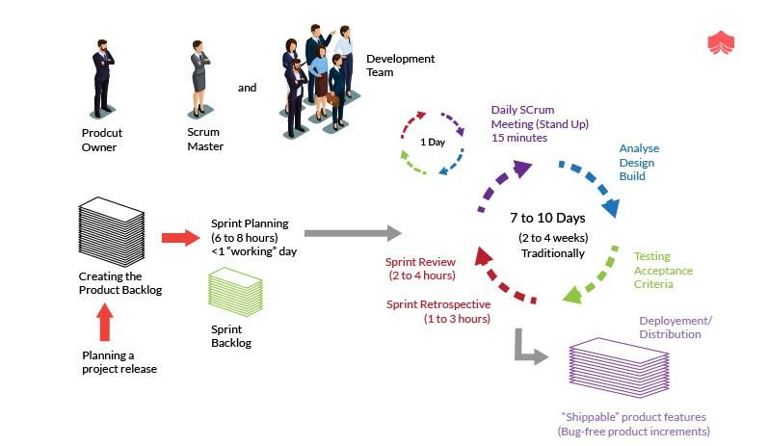
Roles on Agile Team :

